Slide 1
Methods for Designing Rotating Components for Compliance to ISO 1940
John Srodawa, US Army GVSC
DISTRIBUTION STATEMENT A.
Approved for public release; distribution is unlimited. OPSEC # 10959

Slide 2
Introduction
The balancing of rotating components is critical in many designs
  Avoids excessive vibrations, bearing loads, and structural loads
Component balancing can be expensive and time consuming
  Adds significant cost to low production quantity parts
  Balancing is usually one of the last operations performed on a part
    Leads to high scrap costs if the part can not meet balance requirements
Is there a way to ensure that a part will meet balance requirements during the design phase using simple CAD software tools?
Could part tolerances be set during the design phase that would eliminate the need to balance parts?
01

Slide 3
Historical Balancing Requirements
Historical drawings usually state the maximum allowable imbalance in units of oz-in or g-mm
Issues
  The imbalance value is specific to that exact part
  The drawing callout does not control the methods used to balance the part
02

Slide 4
ISO 1940 Balancing Standard
Not well known in the defense community
  Appears complicated at first glance
Advantages
  The standard controls all aspects of the balancing procedures
    How to account for static and dynamic imbalance
    How to account for different balancing machine mounting methods
    How to account for balancing machine bearing locations
  Specifies Balance Quality Grade rather than part specific imbalance
03

Slide 5
ISO 1940 Balance Quality Grade
Balance Quality Grade is application specific, not part specific
  Provides guidance for companies and engineers without historical knowledge
  Simplifies drawing notes
ISO 1940 Table 1 provides balance quality grades for various applications
  A few examples are:
    Large Marine Engines: G4000
    Automobile Wheels and Driveshafts: G40
    Computer Hard Drives: G2.5
    Gyroscopes: G0.4
The Balance Quality Grade is independent of component speed, size, or mass
04

Slide 6
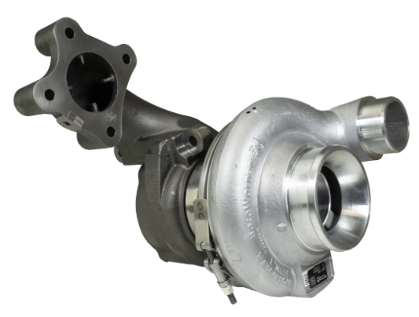
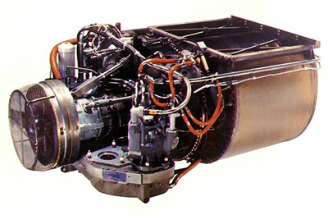
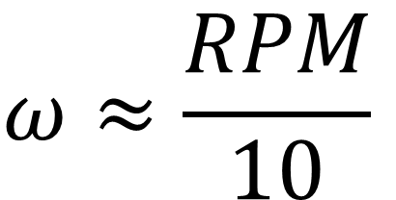
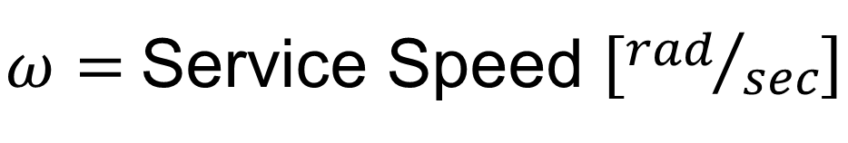
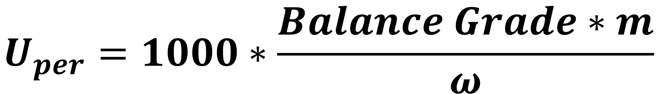
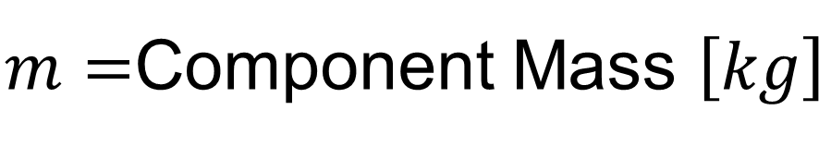
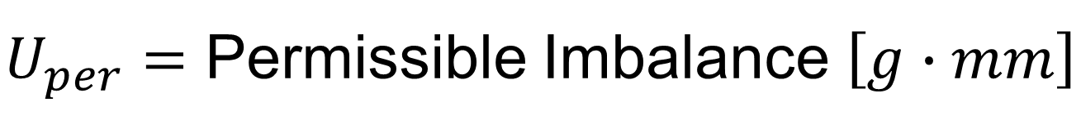
Allowable Imbalance
$$U_{per}=1000∗\frac{Balance Grade∗m}{ω}$$
$U_{per}=$ Permissible Imbalance $\left[g∙mm\right]$
$m=$Component Mass $\left[kg\right]$
$ω=$Service Speed $\left[{rad}/{sec}\right]$
Light Truck Turbocharger
HD Turbine Engine
Rotor Mass | 1 kg
Service Speed | 125,000 rpm
Balance Grade | G6.3
Permissible Imbalance | 0.504 g-mm
$$ω≈\frac{RPM}{10}$$
Rotor Mass | 25 kg
Service Speed | 50,000 rpm
Balance Grade | G6.3
Permissible Imbalance | 31.5 g-mm
05

Slide 7
Component Imbalance Predictions
Component imbalance is usually determined using Finite Element Analysis
  This requires expensive sophisticated software tools
    Most companies have limited licenses dedicated to full time analysts
    Unless you are a full time FEA user, it is easy to make mistakes
    Design iterations involve several employees
    Typically adds cost and schedule to the design effort
Component imbalance can be determined using common 3D CAD software
  These tools are available to all engineers
  No special skills are required
  Multiple iterations can be performed by a single engineer
06

Slide 8
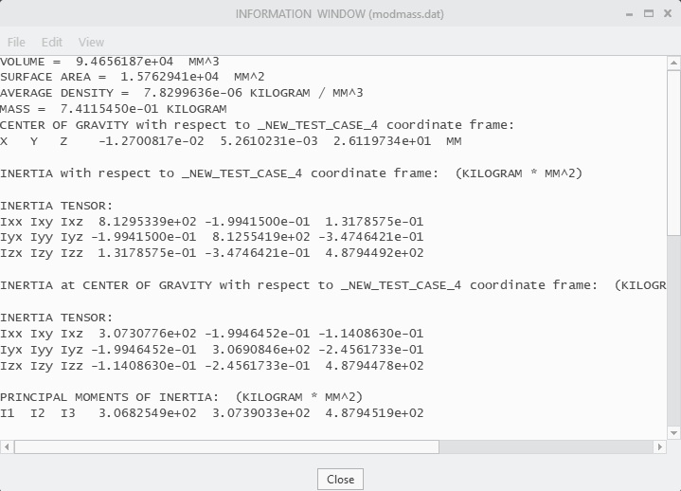





3D CAD Model Mass Data
$$m$$
All five values needed to determine the imbalance can be found in the mass data report
  The report must be made using a coordinate system with the z axis coincident with the axis of rotation
  The inertia tensor about the center of gravity must be used
$$x$$
$$y$$
$$I_{XZ}$$
$$I_{YZ}$$
07

Slide 9
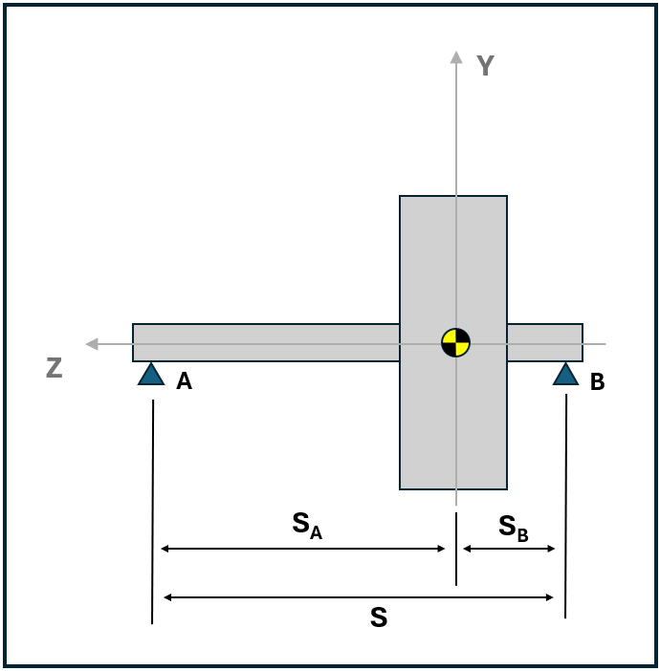
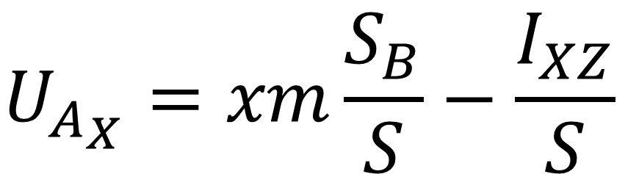
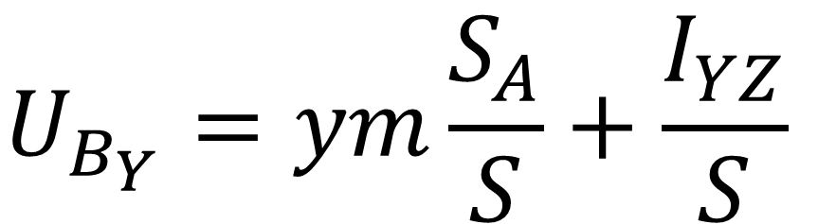
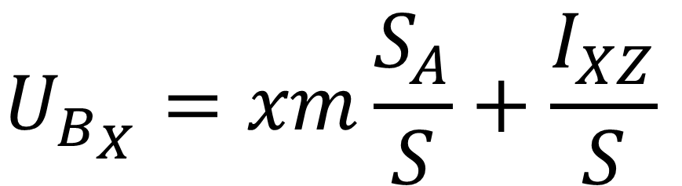
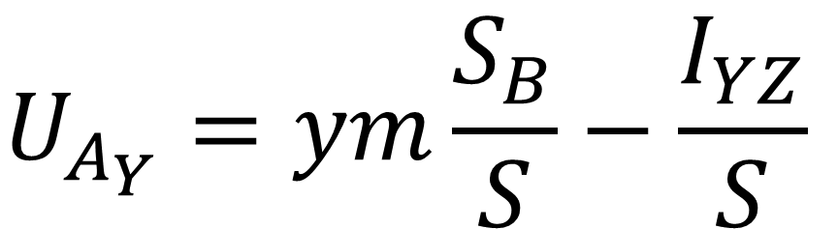
Imbalance Calculations
Rotors Mounted between Bearing Supports
$$U_{A_{X}}=xm\frac{S_{B}}{S}−\frac{I_{XZ}}{S}$$
$$U_{A_{Y}}=ym\frac{S_{B}}{S}−\frac{I_{YZ}}{S}$$
$$U_{B_{X}}=xm\frac{S_{A}}{S}+\frac{I_{XZ}}{S}$$
$$U_{B_{Y}}=ym\frac{S_{A}}{S}+\frac{I_{YZ}}{S}$$
08

Slide 10
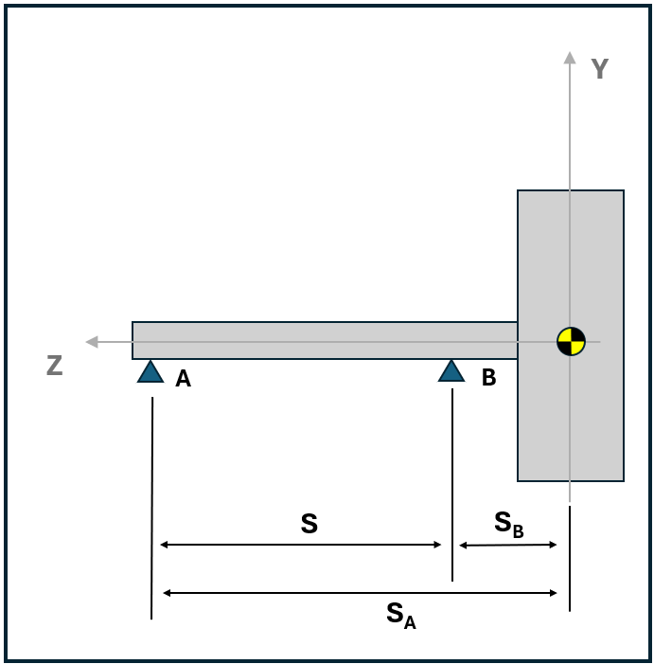
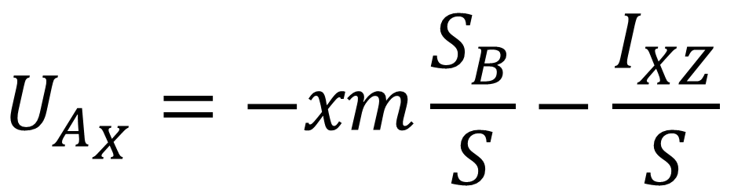
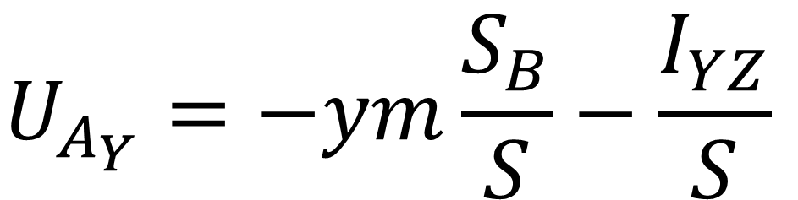
Imbalance Calculations
Overhung Mounted Rotors
$$U_{A_{X}}=−xm\frac{S_{B}}{S}−\frac{I_{XZ}}{S}$$
$$U_{A_{Y}}=−ym\frac{S_{B}}{S}−\frac{I_{YZ}}{S}$$
$$U_{B_{X}}=xm\frac{S_{A}}{S}+\frac{I_{XZ}}{S}$$
$$U_{B_{Y}}=ym\frac{S_{A}}{S}+\frac{I_{YZ}}{S}$$
09

Slide 11
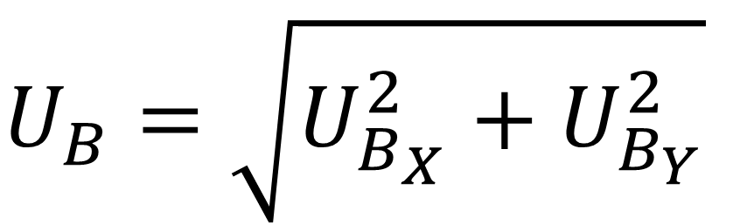
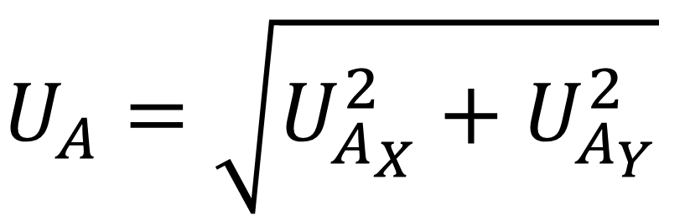

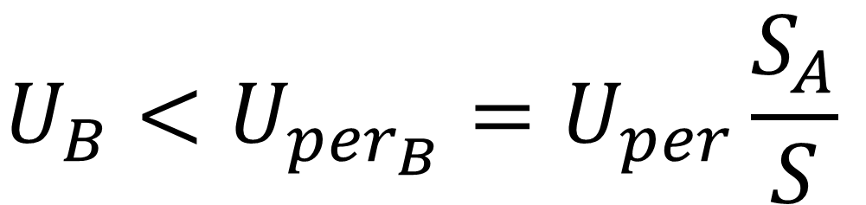
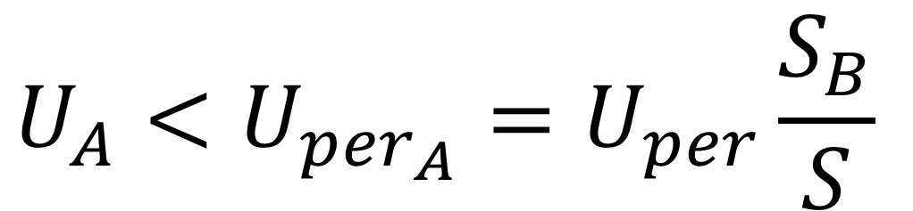
ISO 1940 Compliance
The imbalance magnitude calculated from the 3D CAD data must be less than the permissible imbalance at each bearing allowed by ISO 1940
      $U_{per}$ is calculated per Slide 05
      ISO 1940-1 Clause 7.2 specifies upper and lower limits for $U_{{per}_{A}}$ and $U_{{per}_{B}}$
$$U_{A}=\sqrt{U_{A_{X}}^{2}+U_{A_{Y}}^{2}}$$
$$U_{A}<U_{{per}_{A}}=U_{per}\frac{S_{B}}{S}$$
$$U_{B}=\sqrt{U_{B_{X}}^{2}+U_{B_{Y}}^{2}}$$
$$U_{B}<U_{{per}_{B}}=U_{per}\frac{S_{A}}{S}$$
10

Slide 12
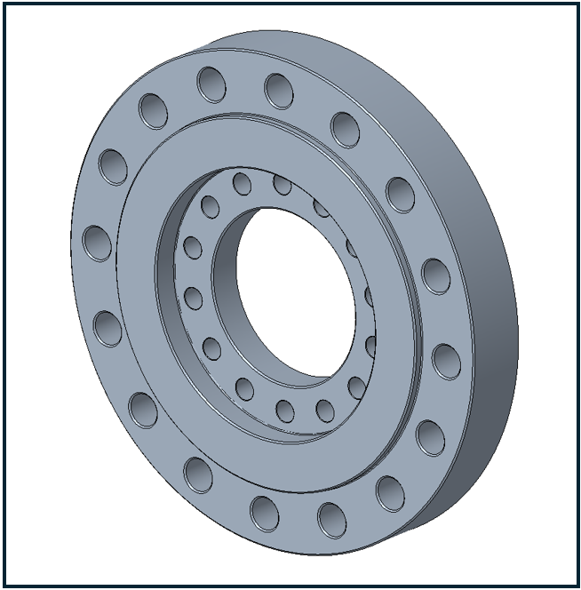
Symmetrical Part Application
Driveshaft Adapter for use in GVSC Vehicle Dynamometer Laboratory
  This part costs ~$3500 to fabricate
  This part costs an additional $5500 to balance
    This is due to the custom fixtures required to mount this part to the balancing machine
  It is possible to eliminate balancing all together by setting part tolerances tight enough to ensure ISO 1940 compliance
11

Slide 13
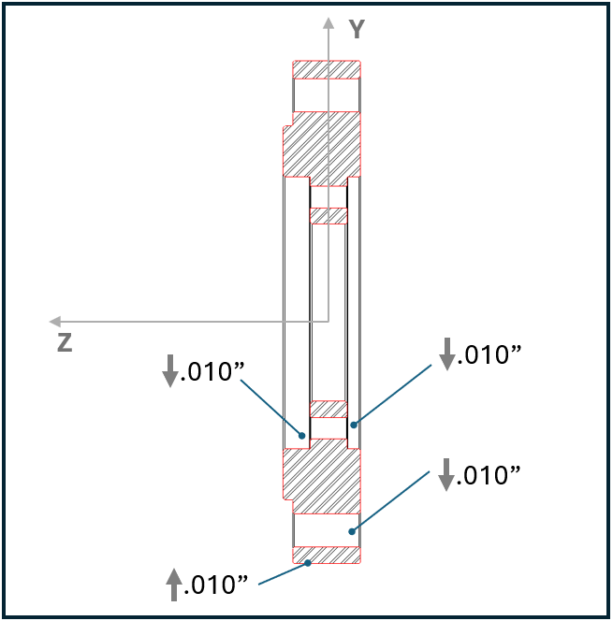
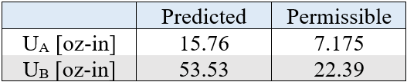
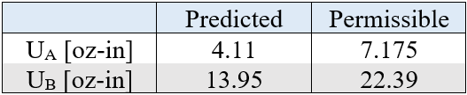
Symmetrical Part Application
The driveshaft adapter was modeled in 3D CAD
  The holes and pilot diameters were intentionally modeled out of position
  The resulting mass property data was assessed for ISO 1940 compliance
    Service Speed = 800rpm
    Balance Quality Grade G16
.020”
Holes
.010”
Holes
.020”
Pilot Diameters
.005”
Pilot Diameters
r
✓
r
✓
12

Slide 14
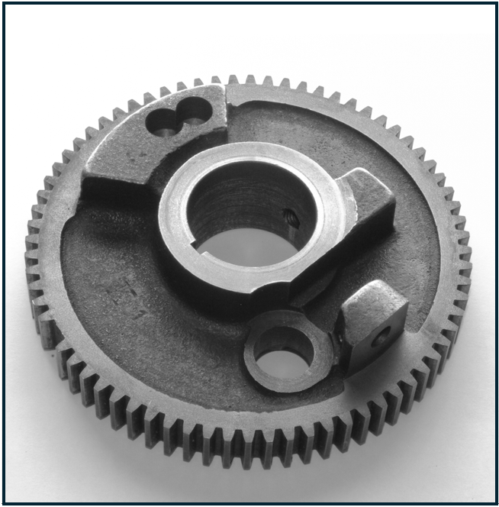
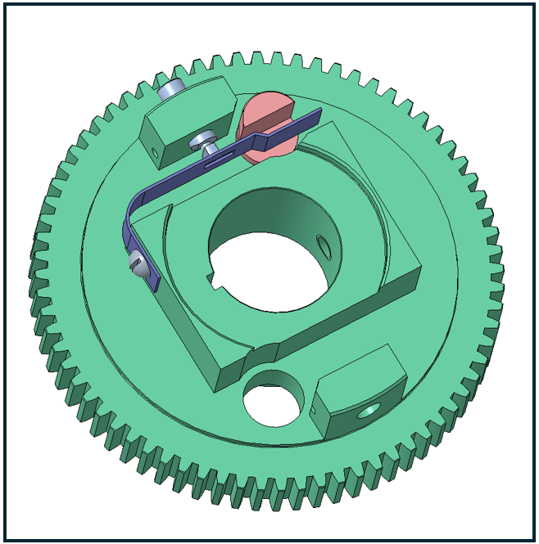
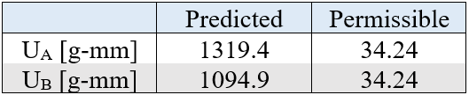
Non-Symmetrical Part Application
Reverse Engineering of a Bull Gear
  The application is a machine tool spindle
  The gear also supports hardware to change between high range and low range gearing
    Service Speed = 1450 rpm
    Balance Quality Grade G6.3
  The initial symmetrical replacement gear failed to meet ISO 1940 balance requirements when gear change hardware is installed
r
r
13

Slide 15
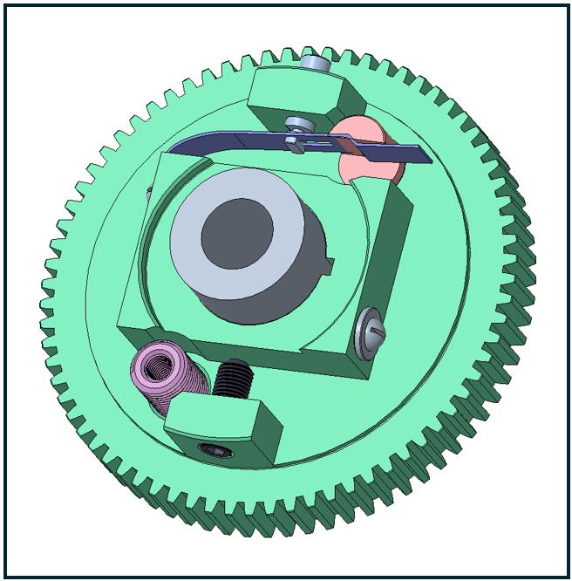
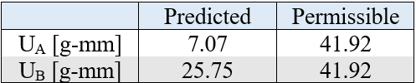
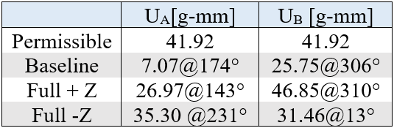
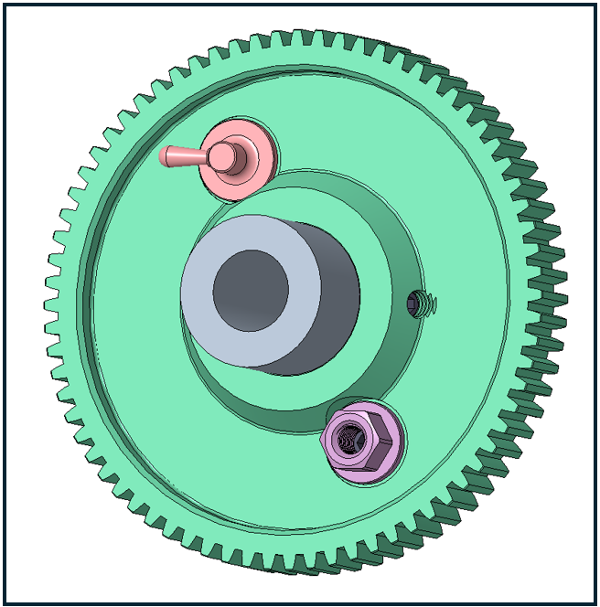
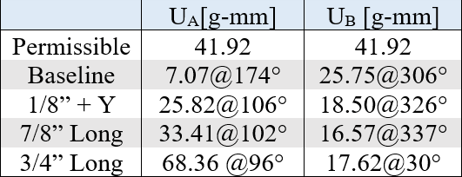
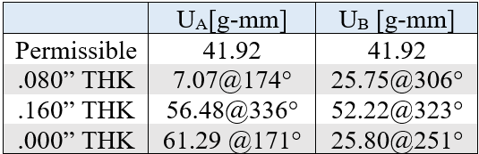
Non-Symmetrical Part Application
The design was modified to include adjustable balance slugs
  3D CAD mass property data was used to verify ISO 1940 compliance and the range of adjustability
A
C
Baseline
5/16-24 UNF Set Screw
B
✓
✓
3/8-24 UNF Set Screw
A
10-32 Washer Thickness
C
B
14

Slide 16
Conclusion
There are several advantages to using ISO 1940
  Provides application specific Balance Quality Grade values
    Especially useful when designing components without corporate knowledge
  Controls balancing practices and methods
  Simplifies drawing notes
    Allows the same note to be used an any rotating component within the same application
15

Slide 17
Conclusion
ISO 1940 compliance can be verified early in the design stage using simple methods
  Any 3D CAD package that can generate mass property data can be used
  Simple equations can convert the mass property data into imbalance values
    This can avoid costly and time-consuming FEA iterations
  These methods can ensure balance compliance early in the design process
  Allows for tolerance studies that can eliminate post fabrication balancing
16

